Slide 1
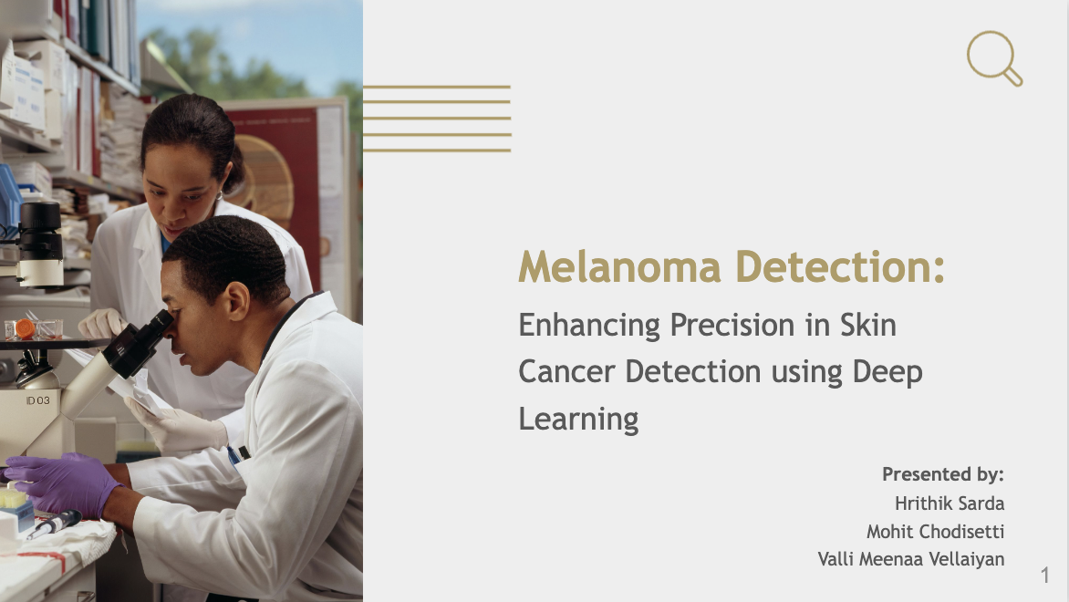

Slide 2
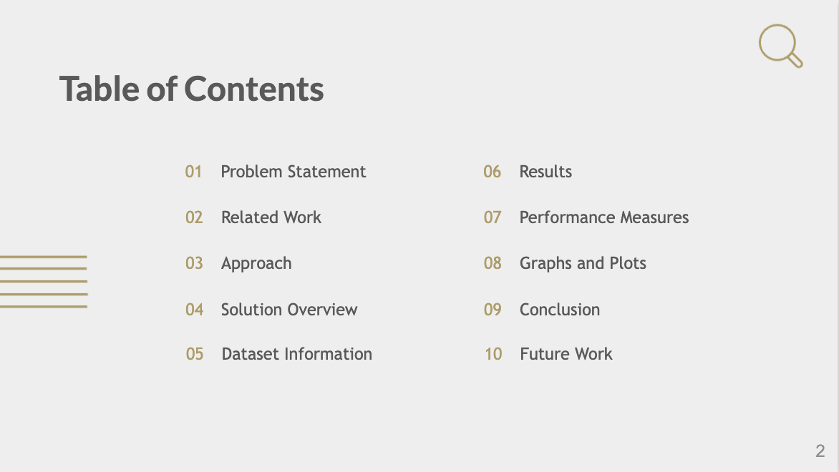

Slide 3
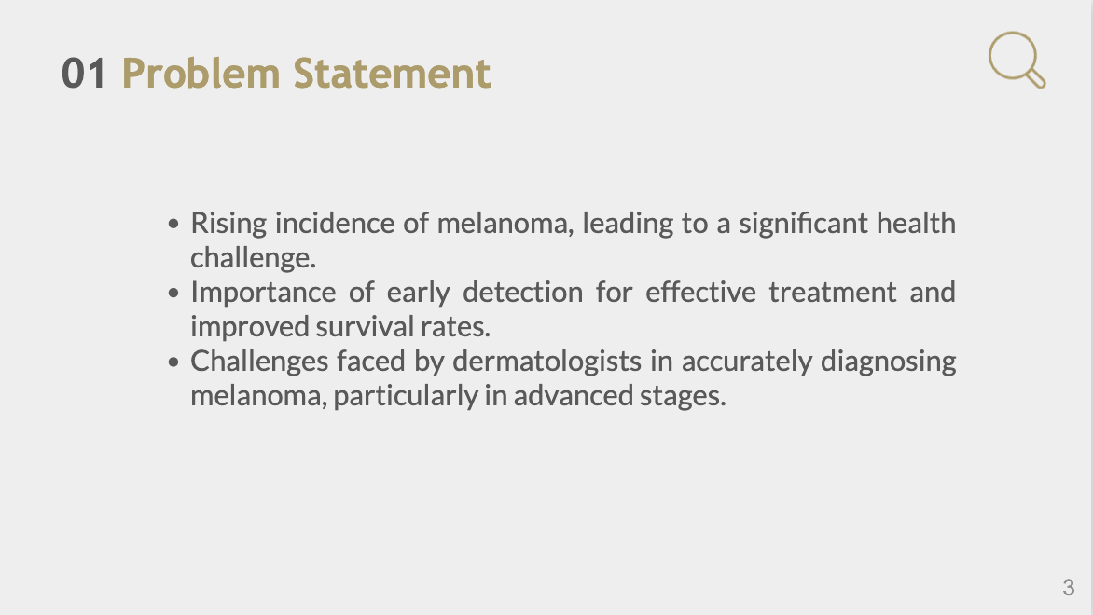

Slide 4
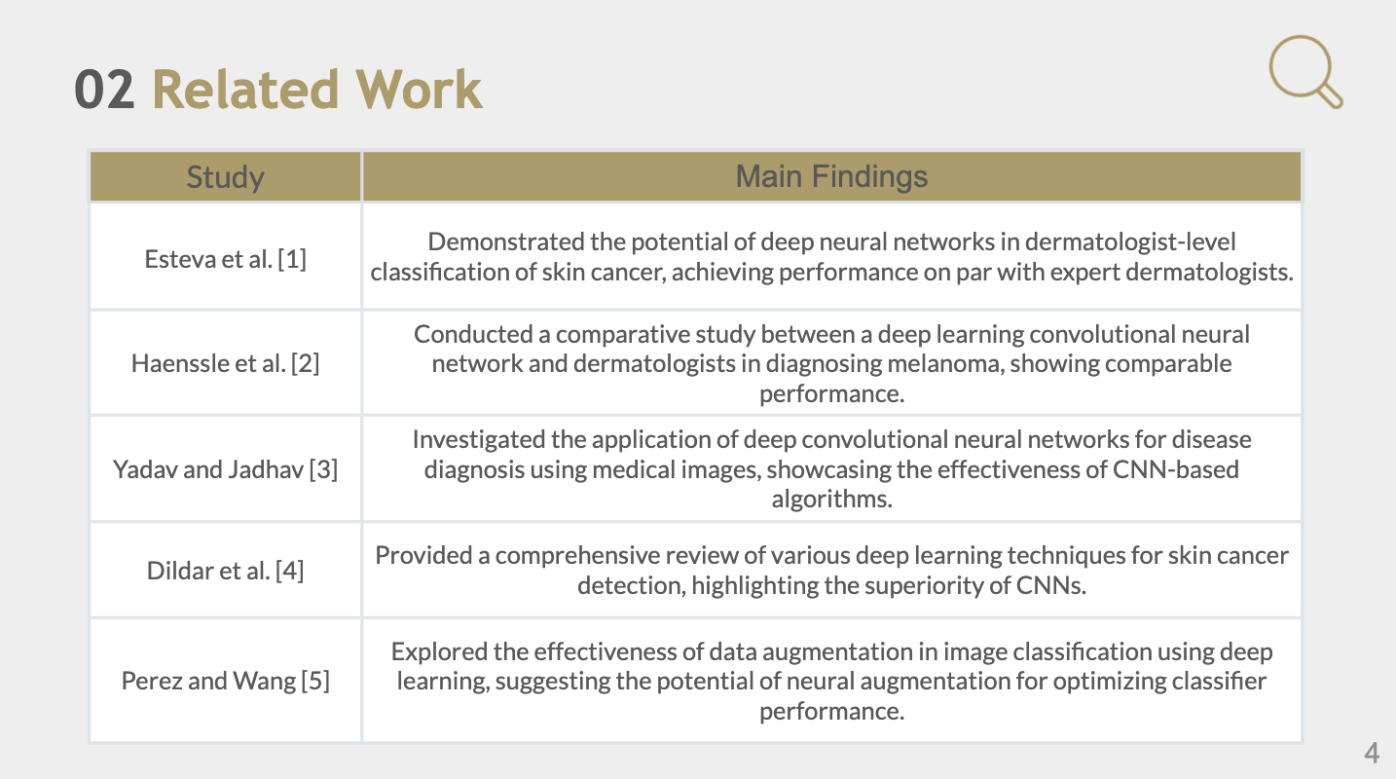
Notes:
The first and second papers addressed how deep neural networks compared to diagnosis by dermatologists, which showed significant advancements in automated cancer detection. It was observed that these networks performed on par with expert dermatologists.
The second and fourth papers that we referred to, focused on the use of convolutional neural networks to diagnose diseases from medical images . These papers highlight the importance of selecting appropriate classification techniques for accurate diagnosis.
The fifth paper that we referred to focused on how data augmentation helps in enhancing image classification in deep learning, and how it helps in optimizing performance. Further refinement and experimentation in medical image classification.

Slide 5
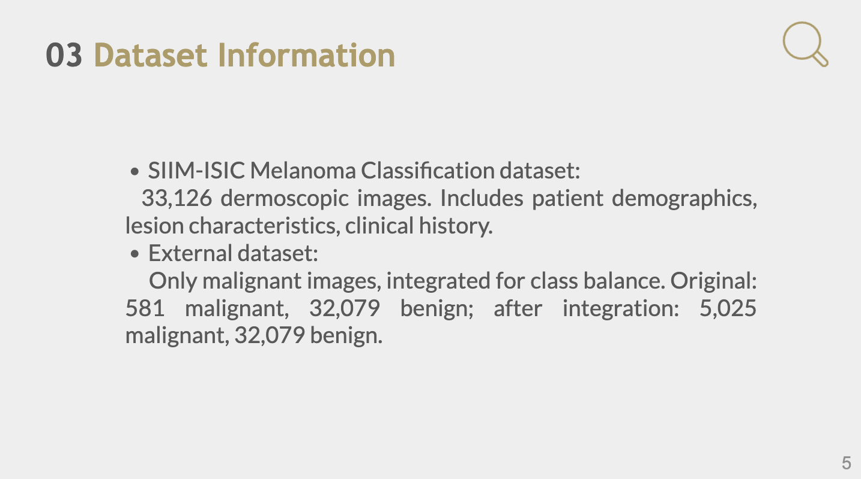
The dataset was generated by the International Skin Imaging Collaboration (ISIC) and images are from the following sources: Hospital Clínic de Barcelona, Medical University of Vienna, Memorial Sloan Kettering Cancer Center, Melanoma Institute Australia, University of Queensland, and the University of Athens Medical School.
Notes:
The dataset was generated by the International Skin Imaging Collaboration (ISIC) and images are from the following sources: Hospital Clínic de Barcelona, Medical University of Vienna, Memorial Sloan Kettering Cancer Center, Melanoma Institute Australia, University of Queensland, and the University of Athens Medical School.

Slide 6
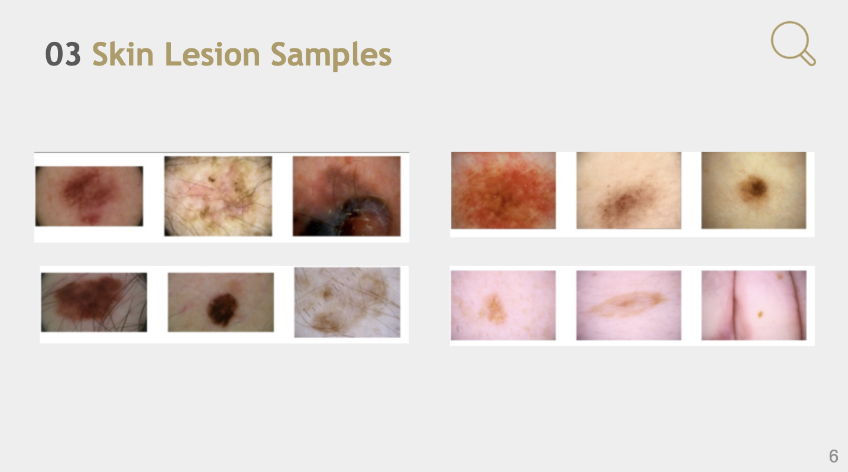
CLASS 1
CLASS 0

Slide 7

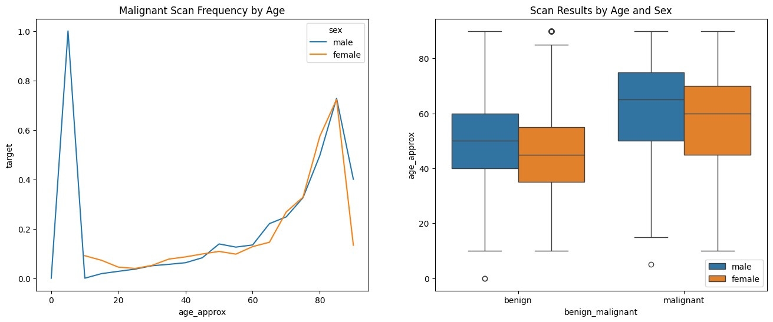
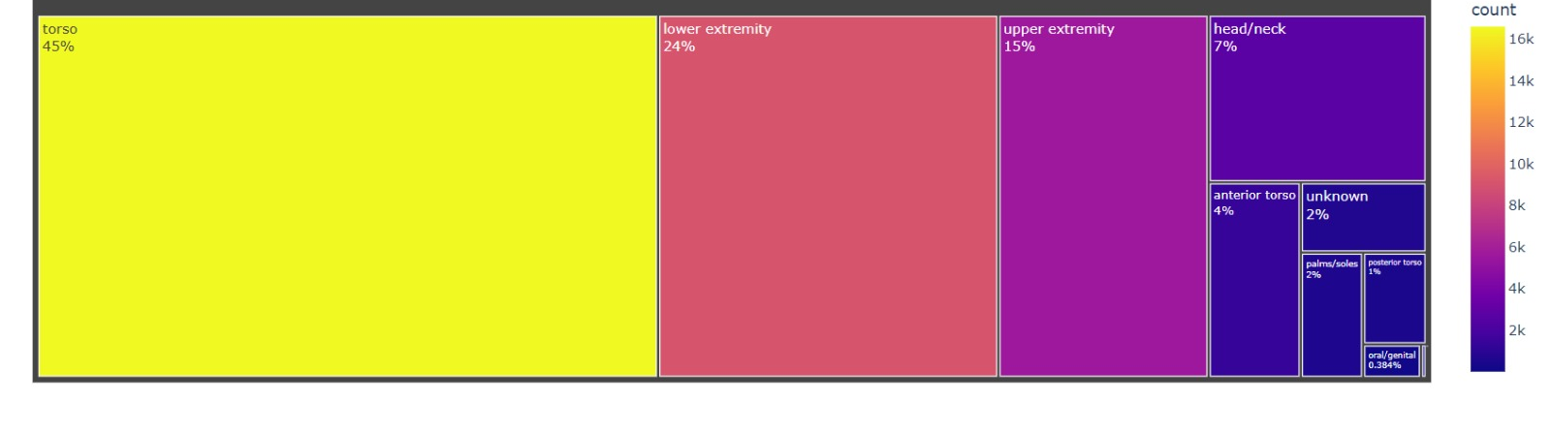
Body Part Ratio by Gender and Target: Looks like some body parts are more likely to be infected, torso, lower, extremity, upper extremity then comes head and neck . Scanned body part locations are similar in order between males and females with small differences on distribution.
The dataset exhibits a skewed age distribution, with the majority of cases concentrated in older age groups, suggesting a need to collect more balanced data or apply appropriate techniques to mitigate potential biases in the melanoma classification model.

Slide 8

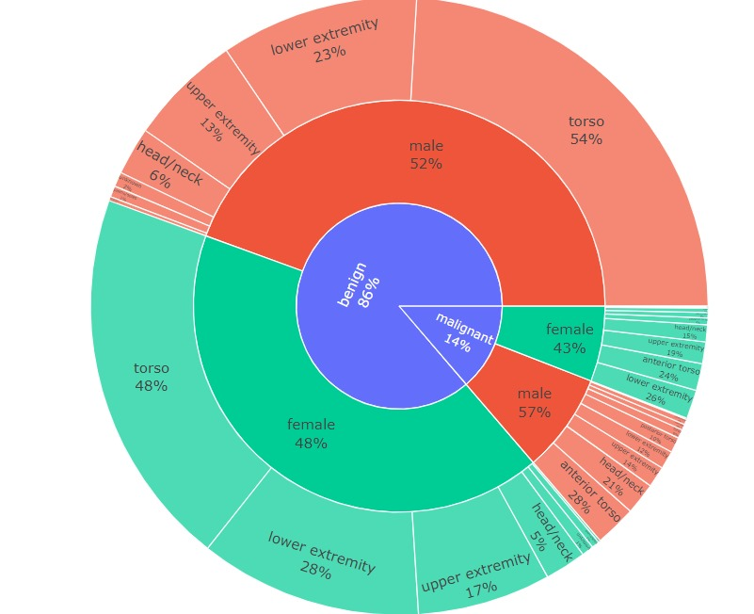
Data From the Chart:
Only 14% of our targets are malignant.
On malignant images males are dominant with 57%
Gender wise benign images are more balance 52-48% male female ratio.
Malignant image scan locations differs based on the patients gender:
Lower extremity is more common with female scans than males 18% males vs 26% females
Again upper extremity malignant scans is common with females than males (14- 19%)
Benign image scan locations more similar between male and female patients.

Slide 9
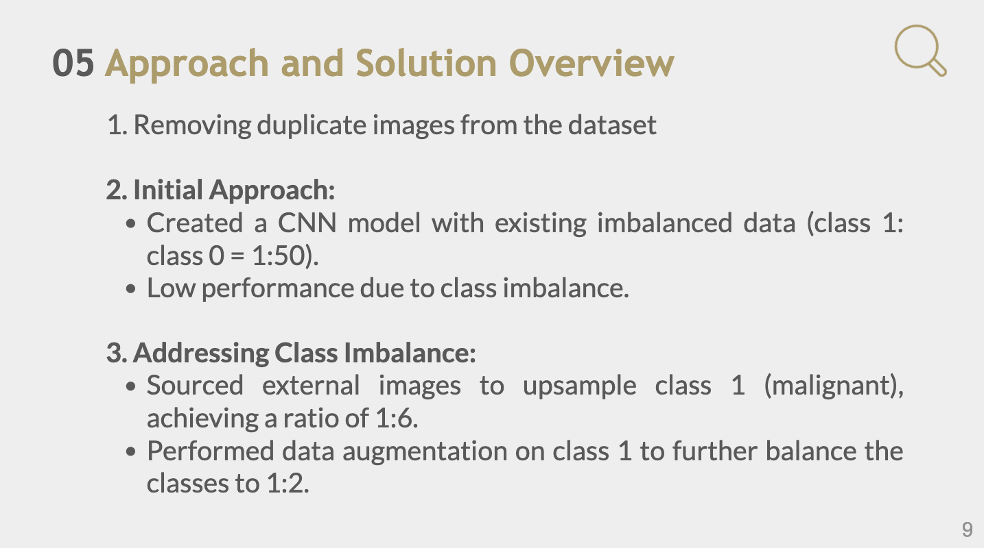

Slide 10
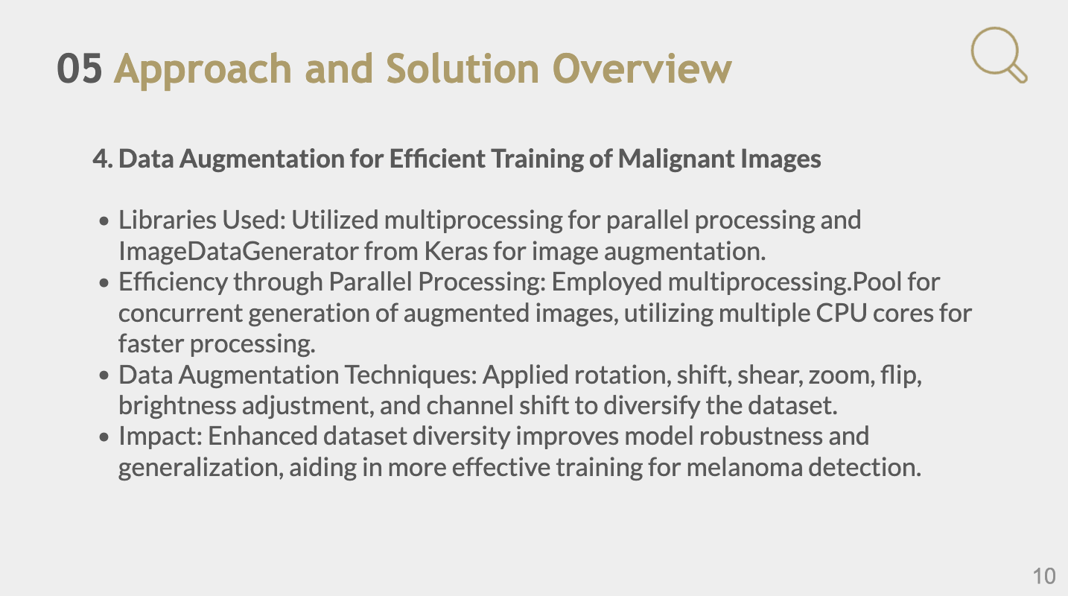

Slide 11
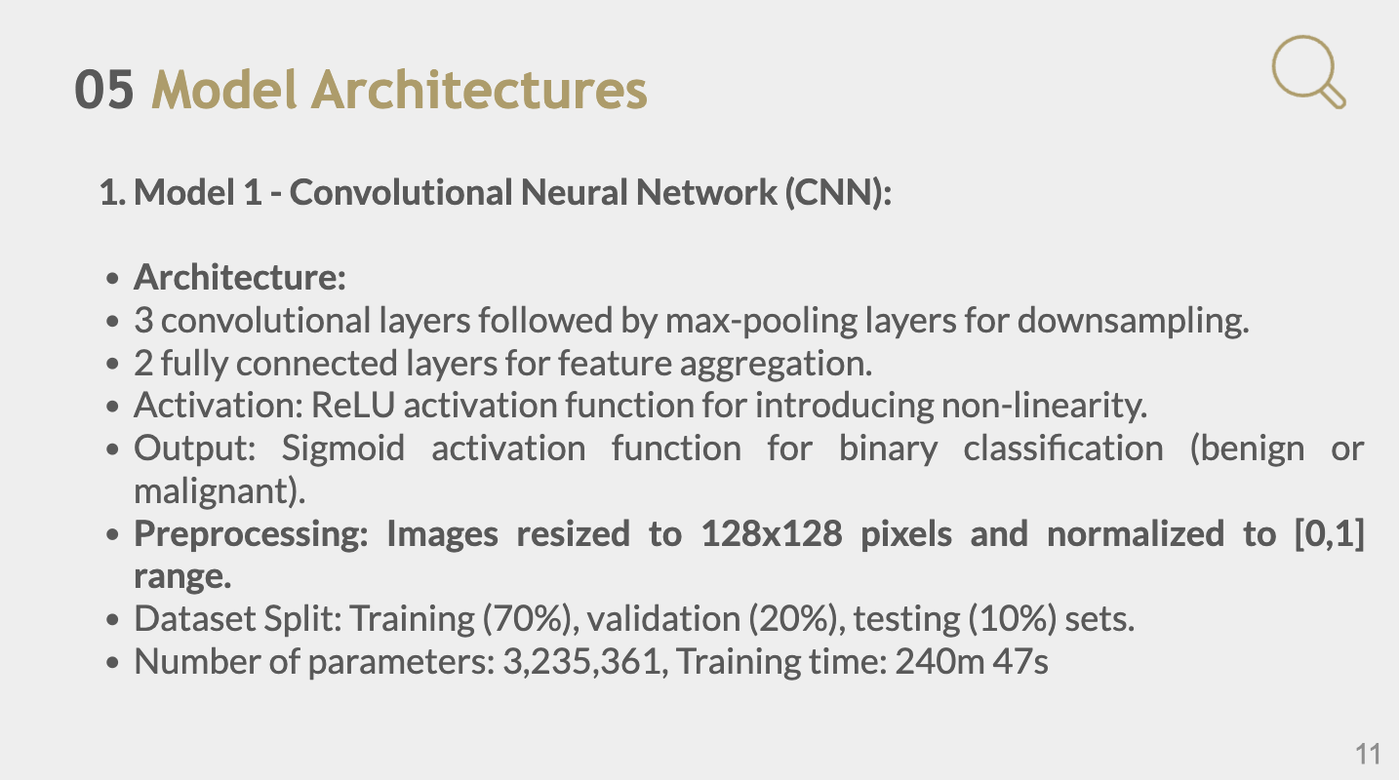

Slide 12
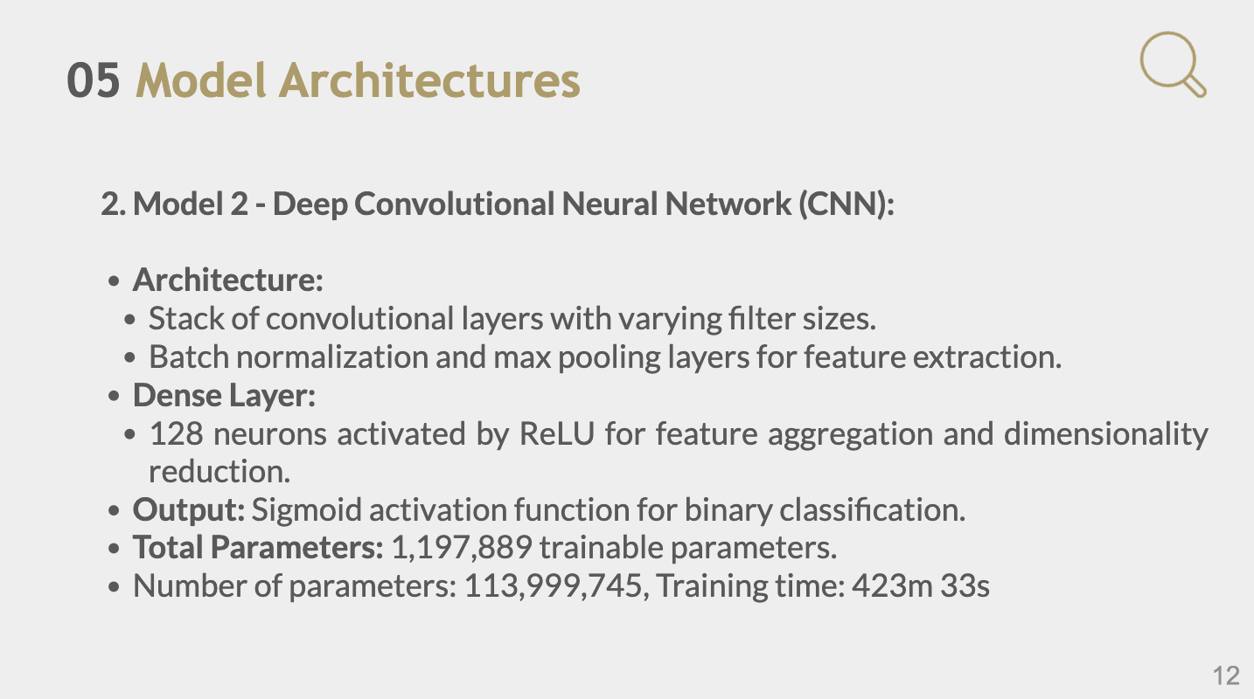

Slide 13
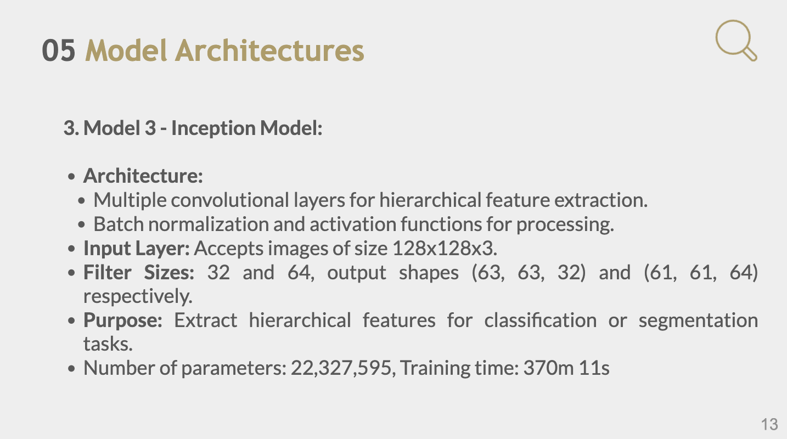

Slide 14
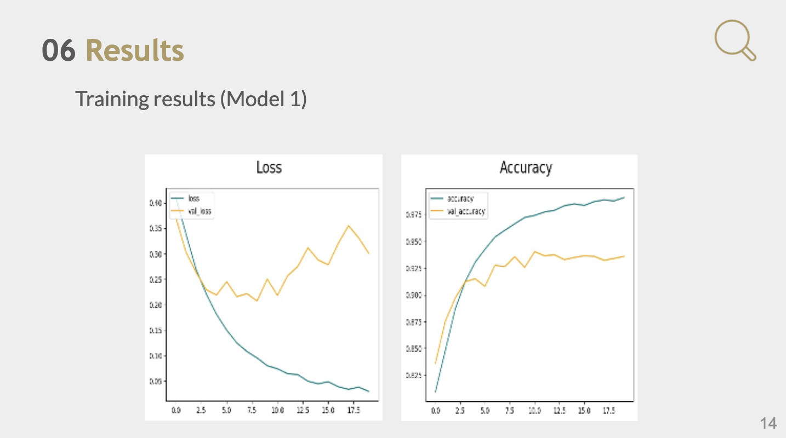

Slide 15
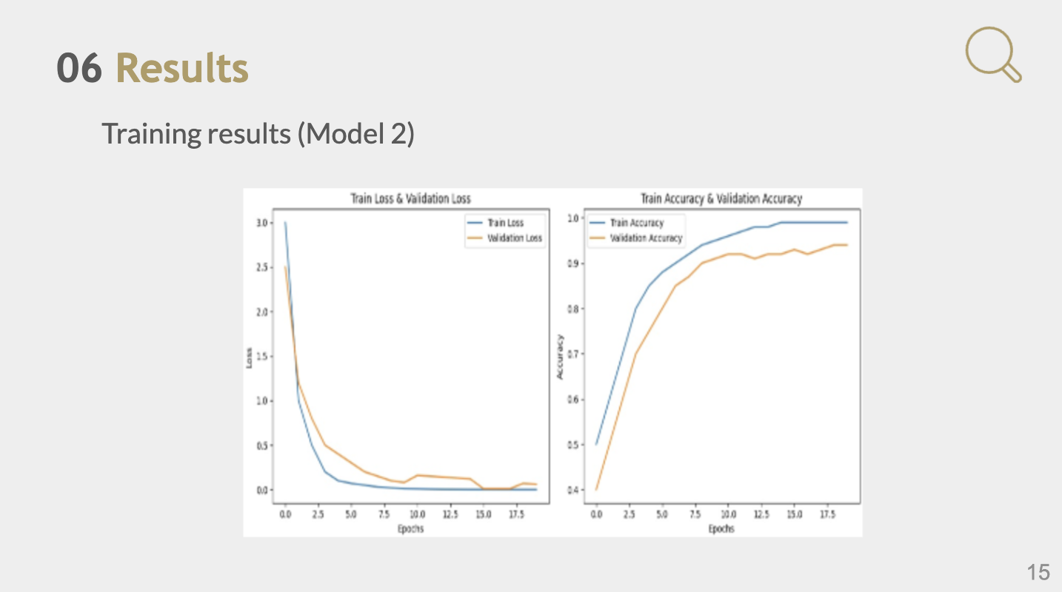

Slide 16
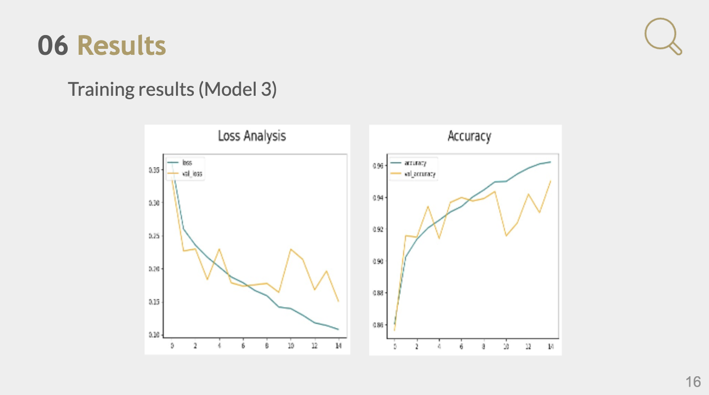

Slide 17
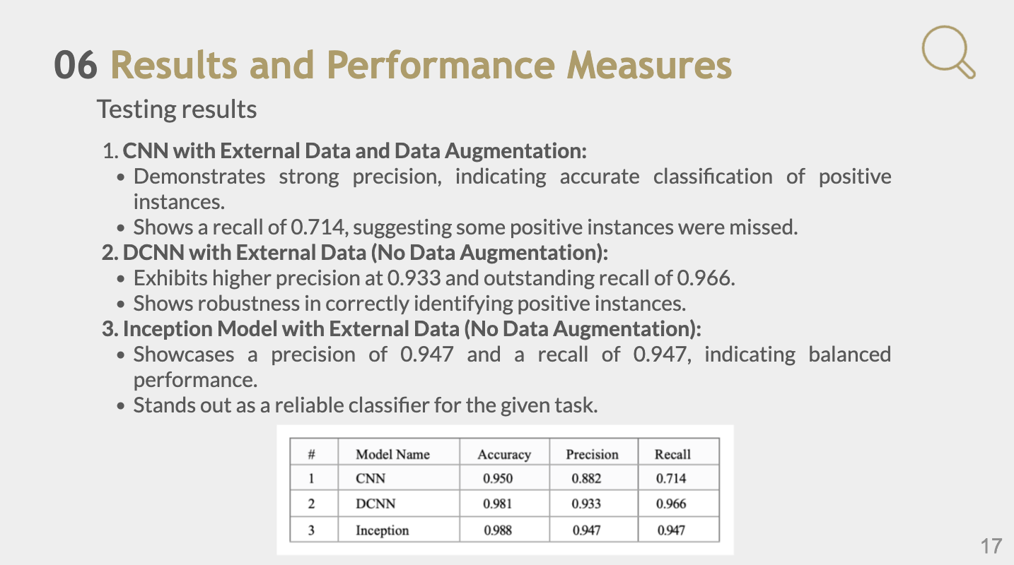

Slide 18
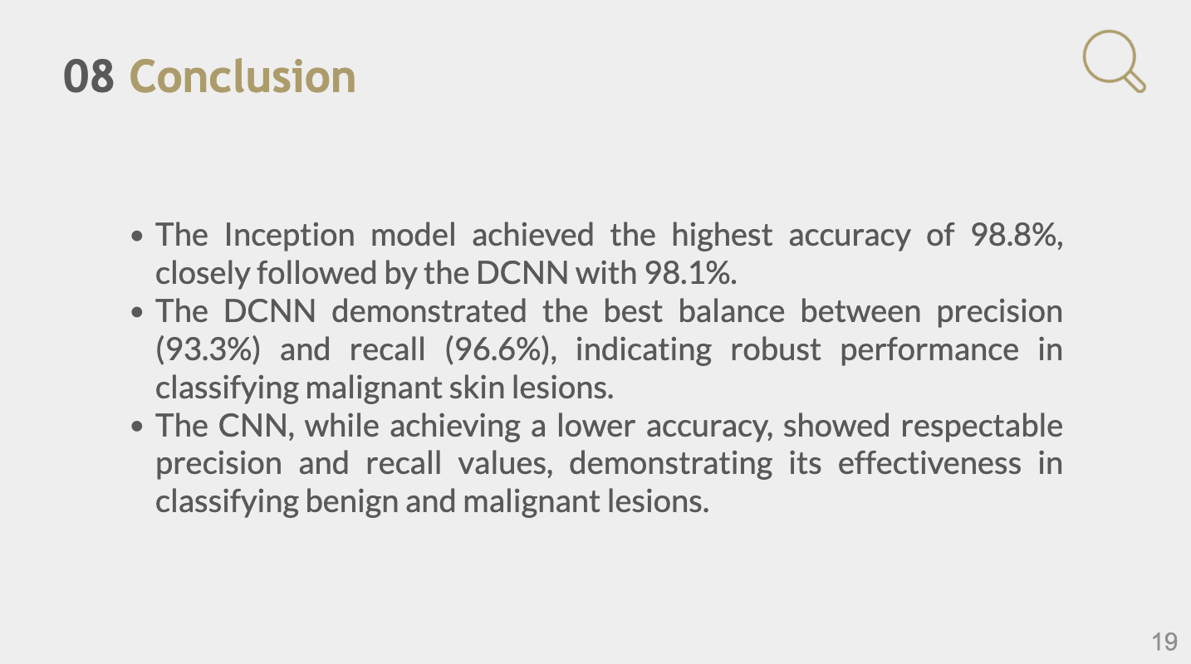

Slide 19
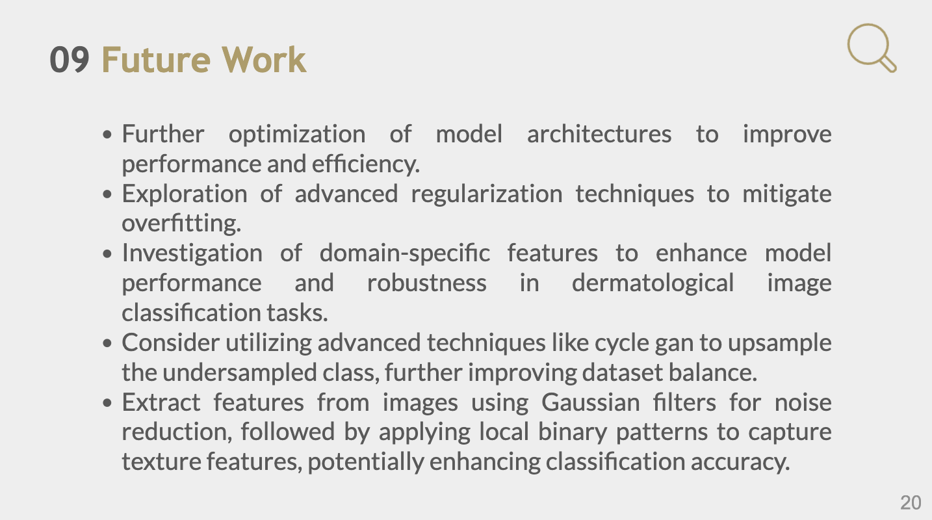

Slide 20


